Slide 1
Car Feature Analysis Report
By Yash Shinde
Jupyter Notebook:- Click Here to Download
Video Presentation:- Click Here to Watch Video Presentation

Slide 2
Project Description!
Car companies want to make the most money while giving people the cars they want. But it's not easy with lots of competition and different kinds of cars like electric and regular ones. A Data Analyst can help by looking at data about cars and prices. They can figure out what things people like in cars and what kinds of cars make the most money. By doing this, the car company can decide how much to charge for their cars and what features to put in new cars. This helps the company do well in the market and make more money in the long run.

Slide 3
Table of Contents
1
2
3
4
Introduction
Analysis
Project description and Tech Stack Used
A. Understanding the Dataset
B. Analysis of Dataset
C. Building the Dashboard
Insights
Conclusion
Summarize the insights and knowledge gained during the project.
Described what I have achieved through the project

Slide 4
"Unlocking the power of data can drive car manufacturers to thrive in a changing world, satisfying consumers while boosting profits."

Slide 5
-> Jupyter Notebook -> Tableau Public -> PowerPoint -> Github -> Google Drive
Tech Stack Used :-

Slide 6
Importing and Exploring Dataset

Slide 7
Importing and Exploring Dataset
First, I created a new notebook and imported libraries and dataset.
application_data = pd.read_csv(“car_data.csv")
Then I explored the dataset using the following programs.
To see the five rows from top and bottom I used head() and tail() respectively.
application_data.head()
application_data.tail()
Then by Using the column function see the names of all the columns/variables.
application_data.columns
By using the describe function obtained all descriptive stats for the numeric variables in the DataSet.
application_data.describe()
By using isnull() method of pandas data frame calculated total null values in each variable.
car_data.isnull().sum()
Then filled those null values with mean, median or mode. (According to variables)
car_data['Engine HP'] = car_data['Engine HP'].fillna(car_data['Engine HP'].mean())
car_data['Engine Cylinders'] = car_data['Engine Cylinders'].fillna(car_data['Engine Cylinders'].median())
car_data['Engine Fuel Type'] = car_data['Engine Fuel Type'].fillna(car_data['Engine Fuel Type'].mode())

Slide 8
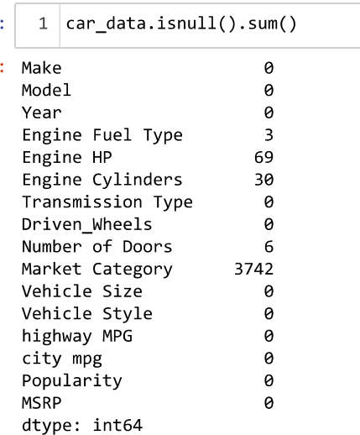
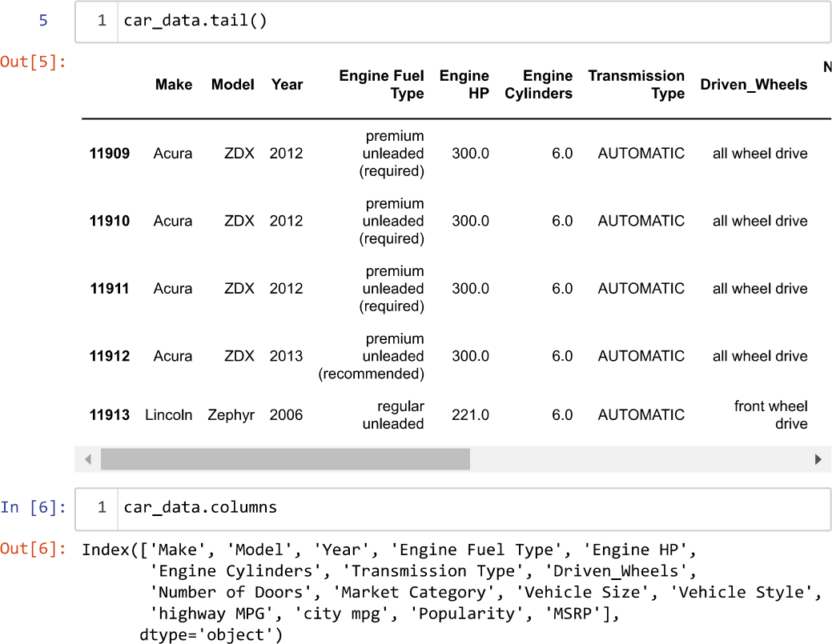
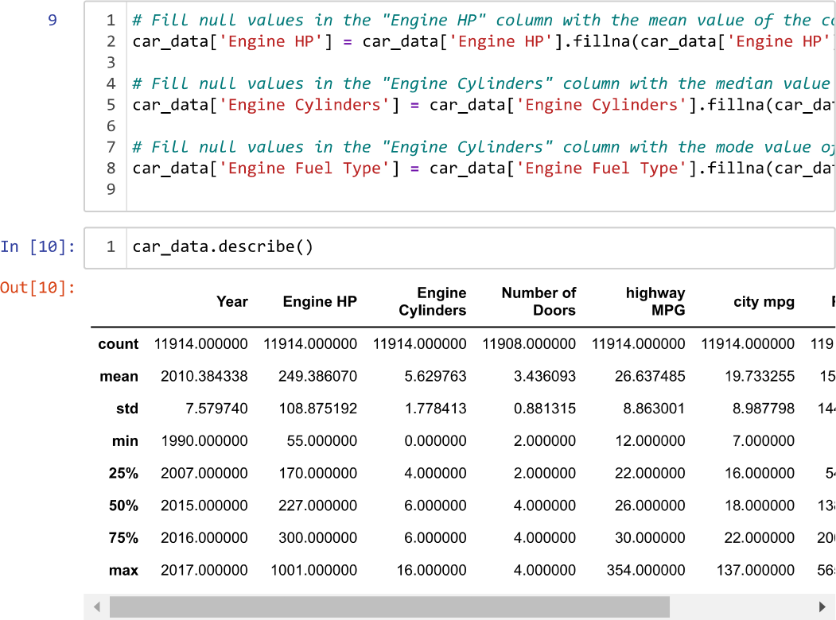
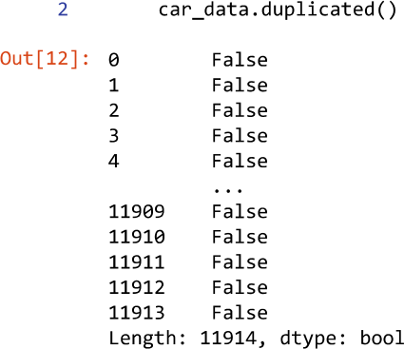

Slide 9
A
Understanding the Dataset
Gain insights into various aspects of the automotive industry.

Slide 10
Understanding the Dataset
Analyzing trends in the car features and pricing over time.
plt.figure(figsize=(12, 6))
sns.lineplot(x='Year', y='MSRP', data=car_data)
plt.title('Trends in Car Prices Over Time')
plt.xlabel('Year')
plt.ylabel('MSRP (Price)')
plt.show()
Compare fuel efficiency of different types of cars
plt.figure(figsize=(12, 6))
sns.boxplot(x='Engine Fuel Type', y='city mpg', data=car_data)
plt.title('Comparison of City MPG by Engine Fuel Type')
plt.xlabel('Engine Fuel Type')
plt.ylabel('City MPG')
plt.xticks(rotation=90)
plt.show()

Slide 11
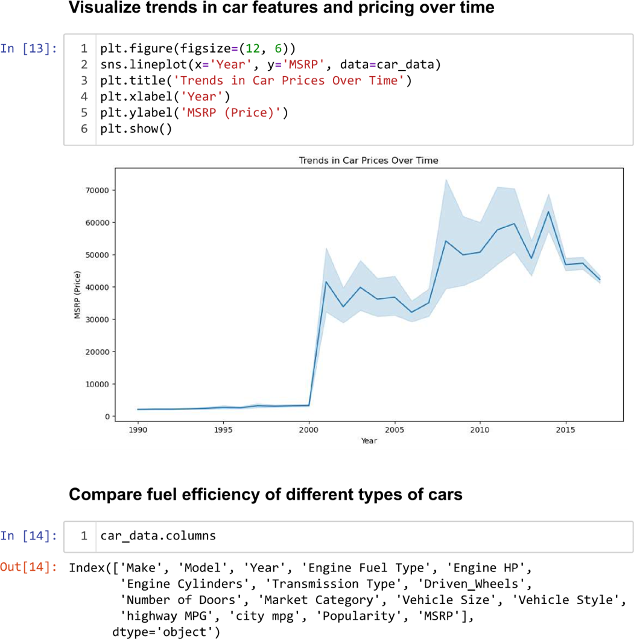

Slide 12
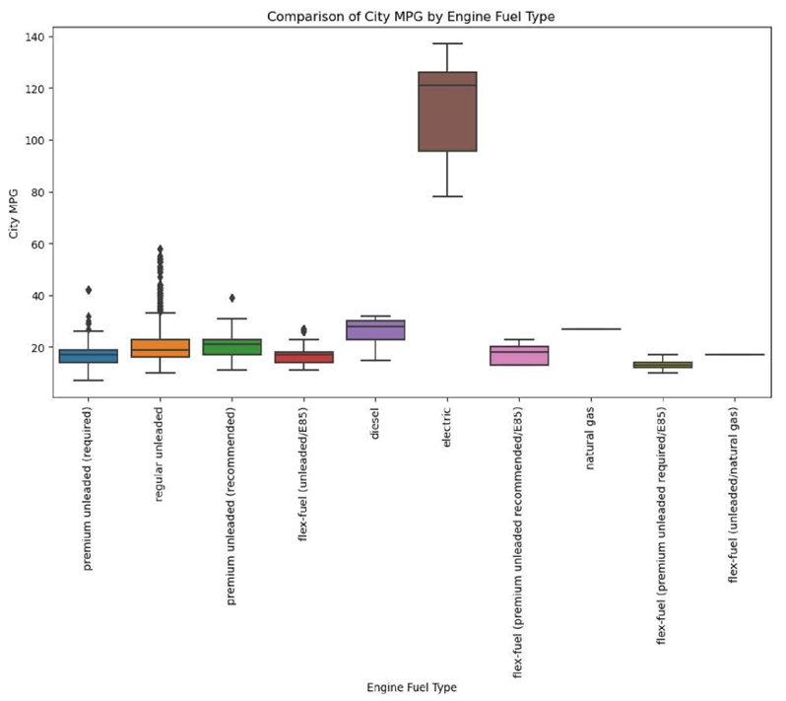

Slide 13
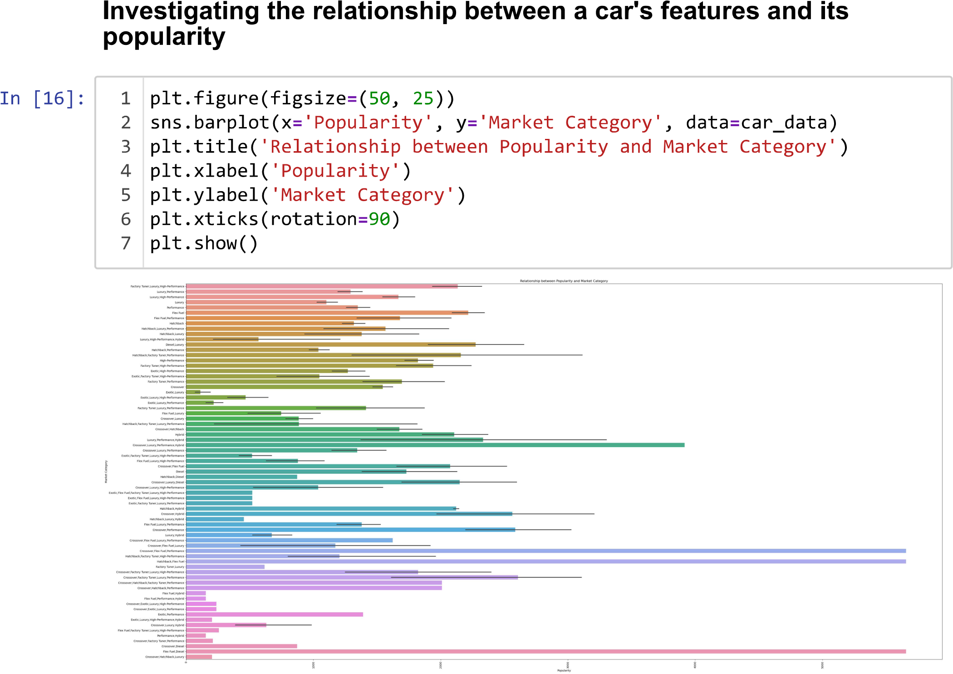

Slide 14
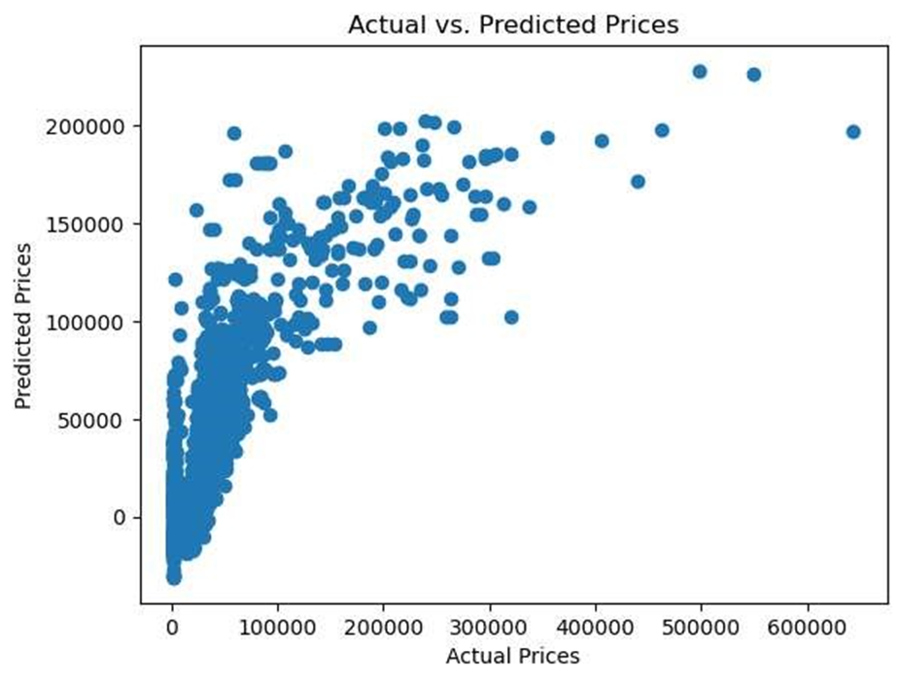
Understanding the Dataset
Predicting the price of a car based on its features and market category: By using the various features and market category variables in the dataset, I have developed a model to predict the price of a car. This could help manufacturers and consumers understand how different features affect the price of a car and make informed decisions about pricing and purchasing.

Slide 15
B
Analysis of Dataset
Finding valuable insights using data analysis techniques such as regression analysis, pivot tables, sensitivity analysis, optimization, and time series analysis.

Slide 16
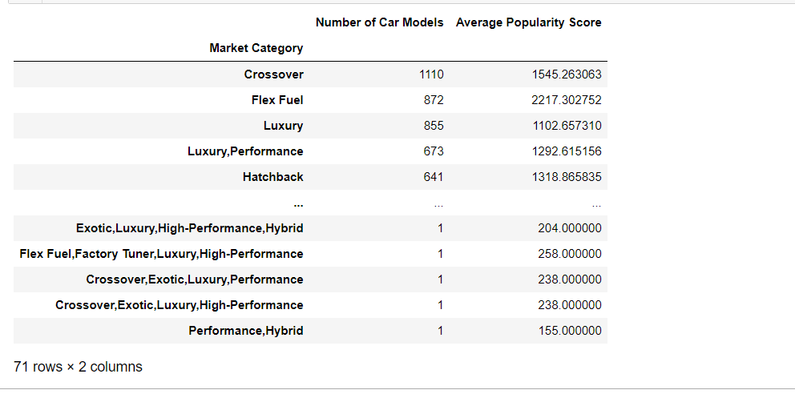
How does the popularity of a car model vary across different market categories?
Task 1.A: : Creating a pivot table that shows the number of car models in each market category and their corresponding popularity scores.

Slide 17
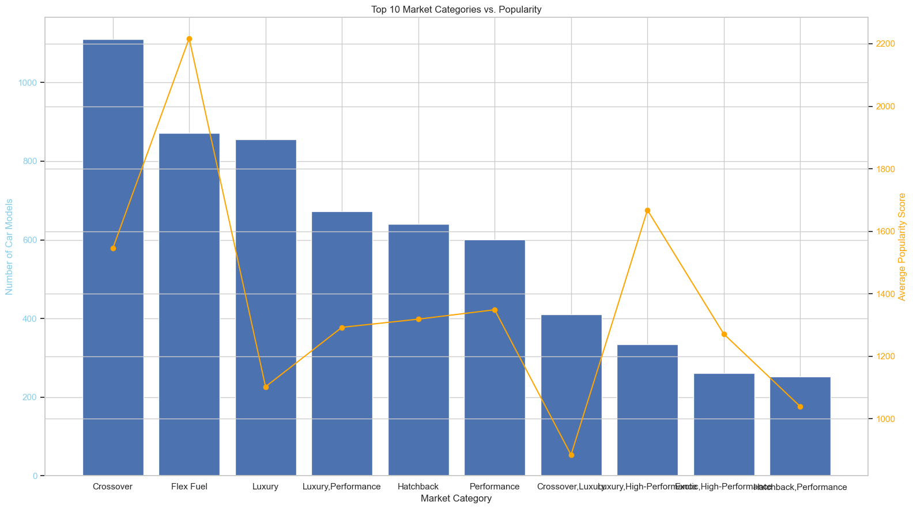
Task 1.B: Creating a combo chart that visualizes the relationship between market category and popularity.

Slide 18
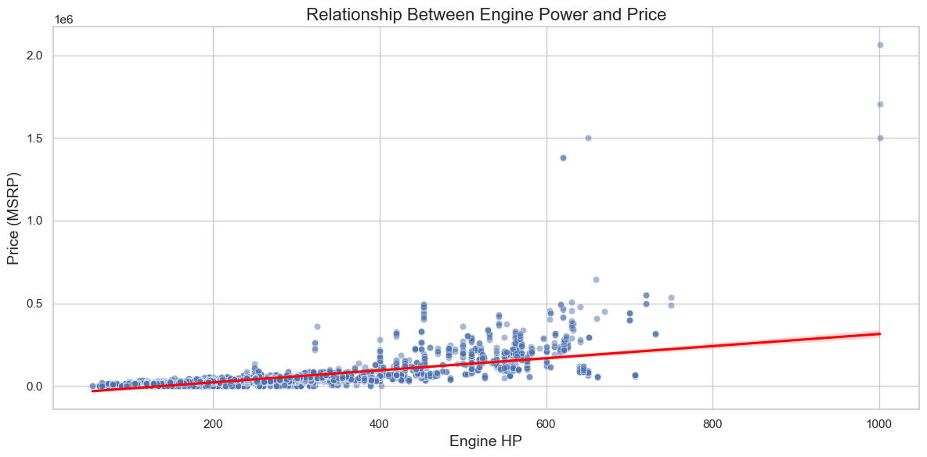
What is the relationship between a car's engine power and its price?
Task 2: Creating a scatter chart that plots engine power on the x-axis and price on the y-axis. Add a trendline to the chart to visualize the relationship between these variables.

Slide 19
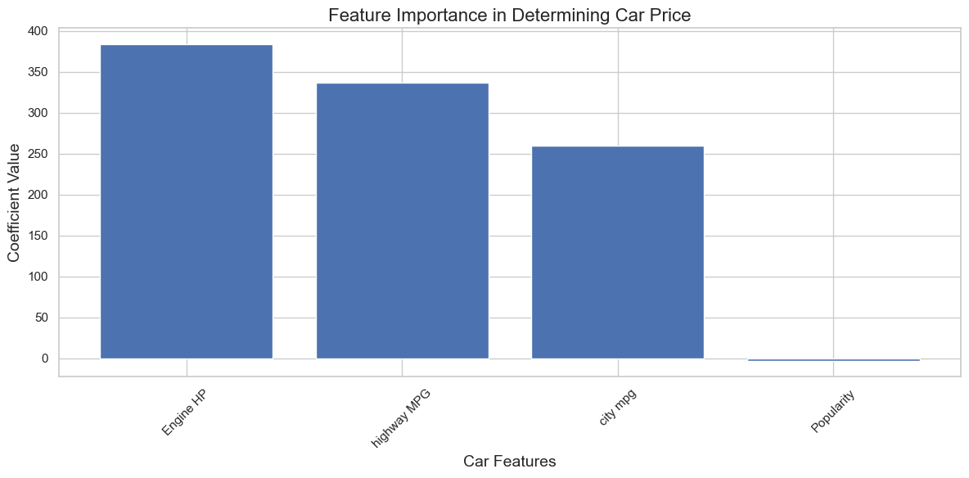
Which car features are most important in determining a car's price?
Task 3: Using regression analysis to identify the variables that have the strongest relationship with a car's price.

Slide 20
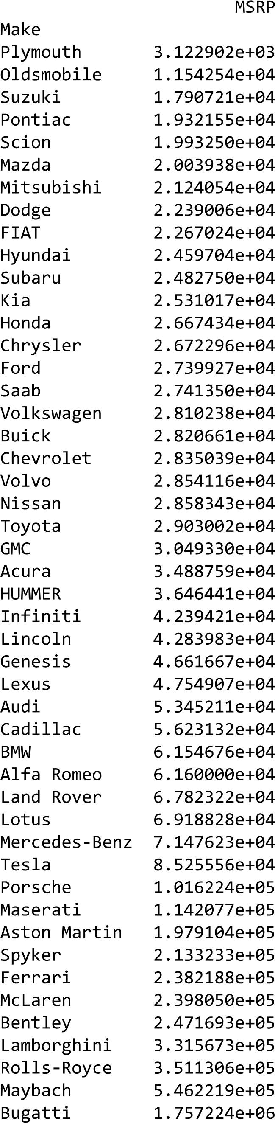
How does the average price of a car vary across different manufacturers?
Task 4.A: Creating a pivot table that shows the average price of cars for each manufacturer

Slide 21
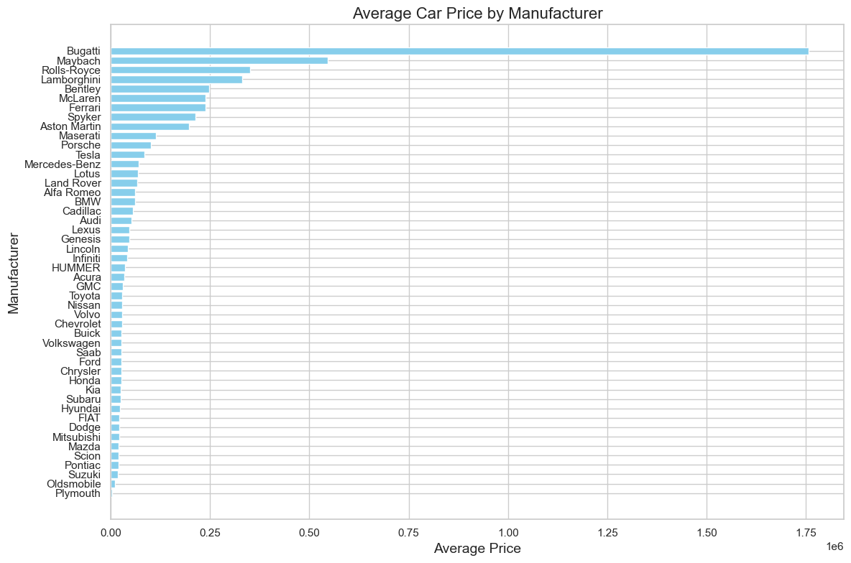
Task 4.B: Creating a bar chart to visualize the relationship between manufacturer & average price.

Slide 22
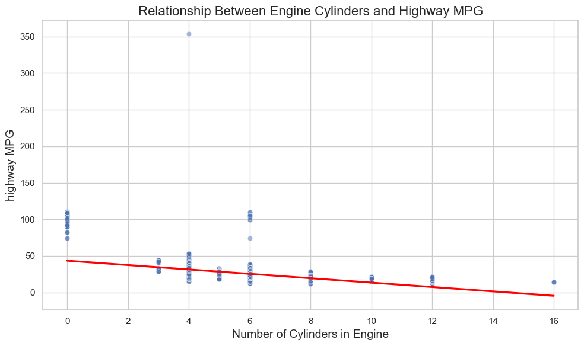
What is the relationship between fuel efficiency and the number of cylinders in a car's engine?
Task 5. A: Creating a scatter plot and trend line with the number of cylinders on the x-axis and highway MPG on the y-axis.

Slide 23
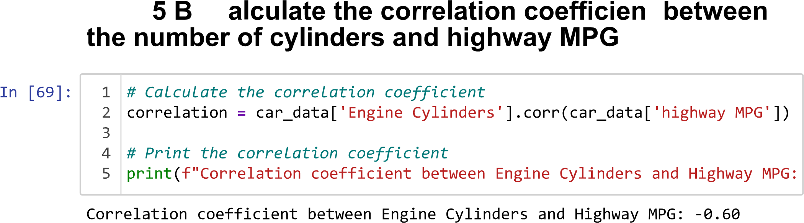
What is the relationship between fuel efficiency and the number of cylinders in a car's engine?
Task 5.B: Calculate the correlation coefficient between the number of cylinders and highway MPG
Inference :- A negative value indicates a negative correlation. i.e., as number of cylinders increases, highway MPG decreases

Slide 24
C
Building the Dashboard
Creating the Interactive Dashboard using filters and slicers.

Slide 25
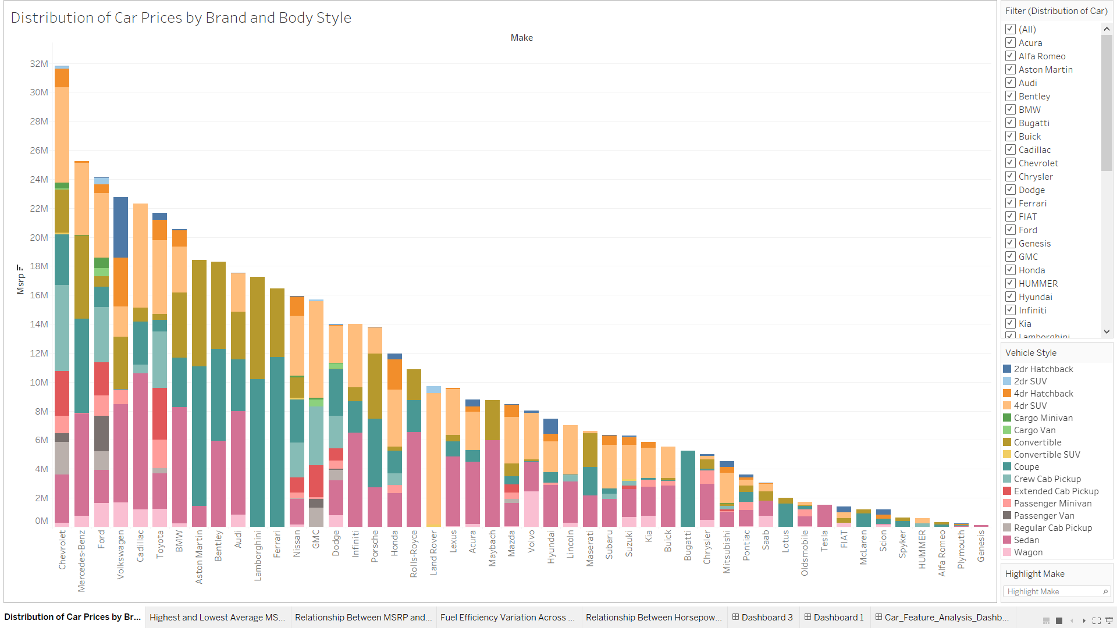
Task 1: How does the distribution of car prices vary by brand and body style?

Slide 26
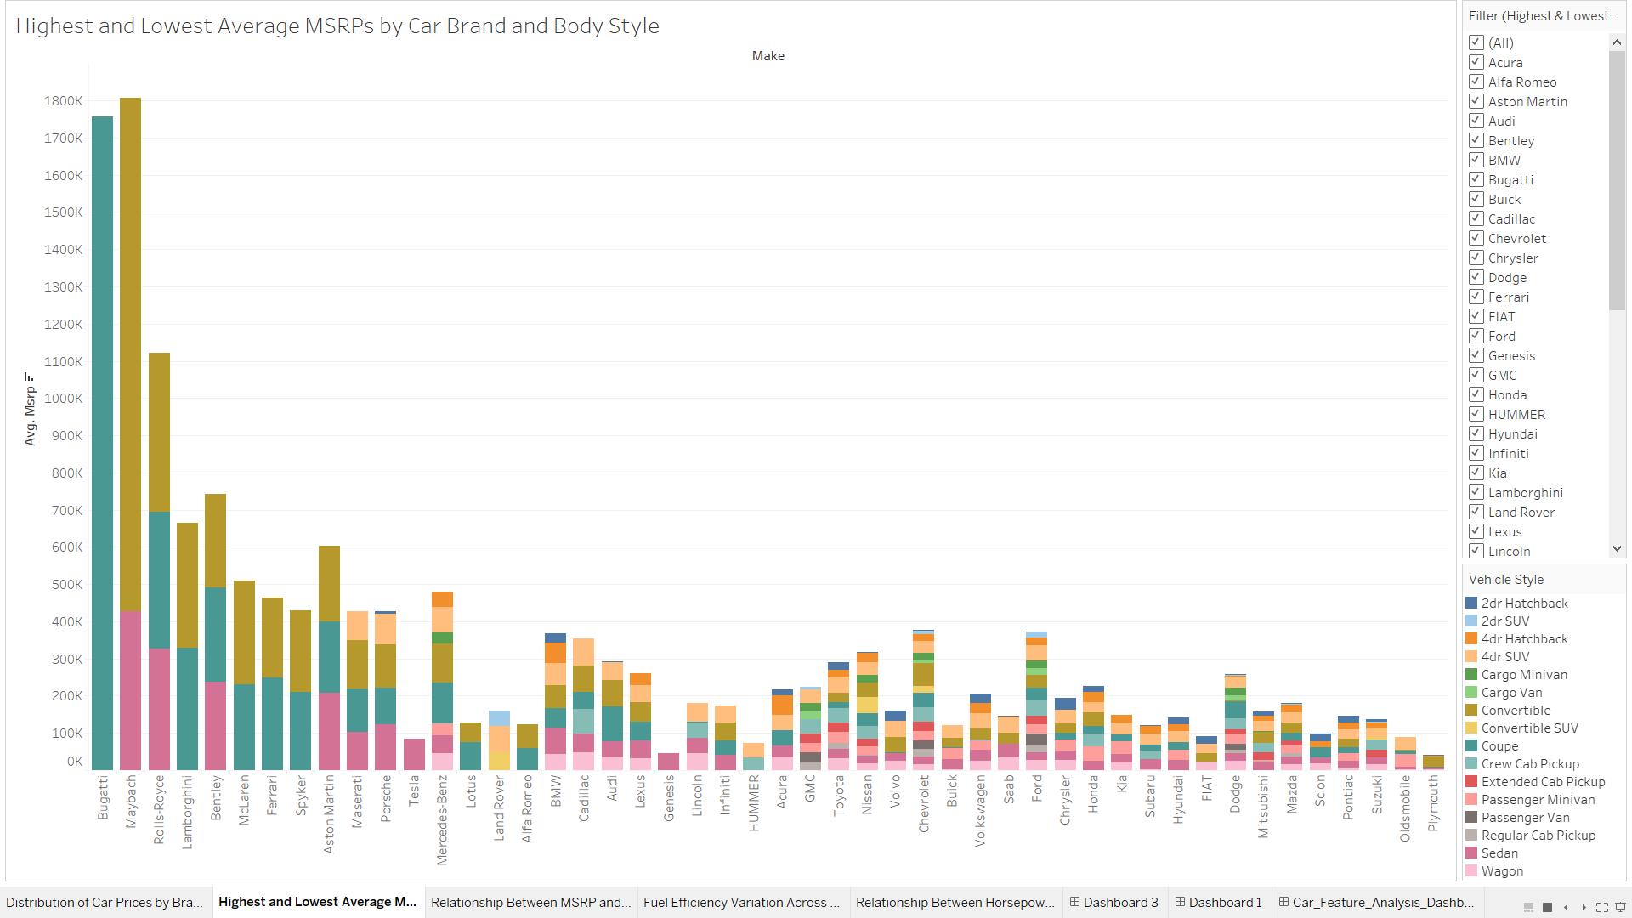
Task 2: Highest and Lowest Average MSRPs by Car Brand and Body Style

Slide 27
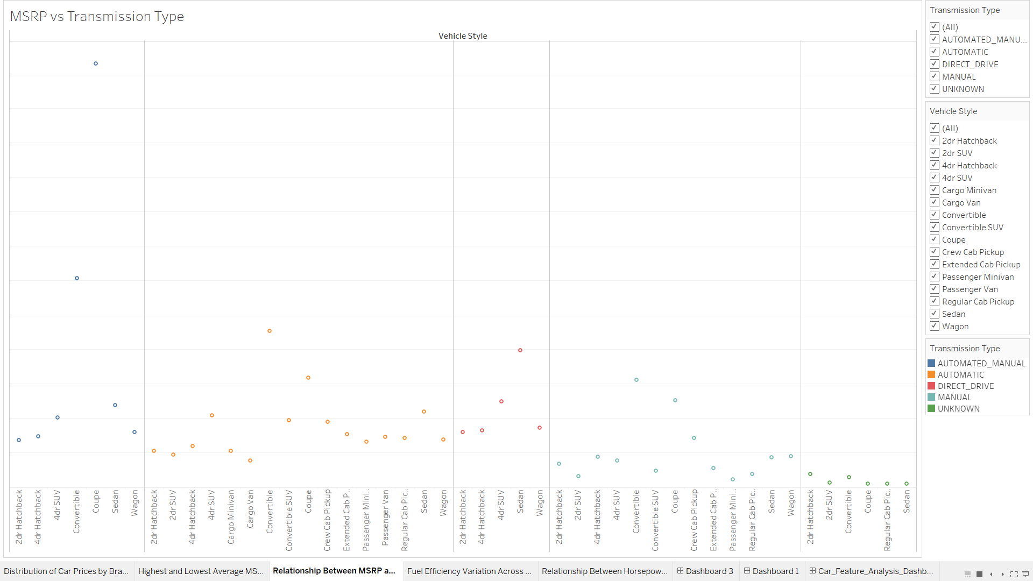
Task 3: How do the different features such as transmission type affect the MSRP, and how does this vary by body style?

Slide 28
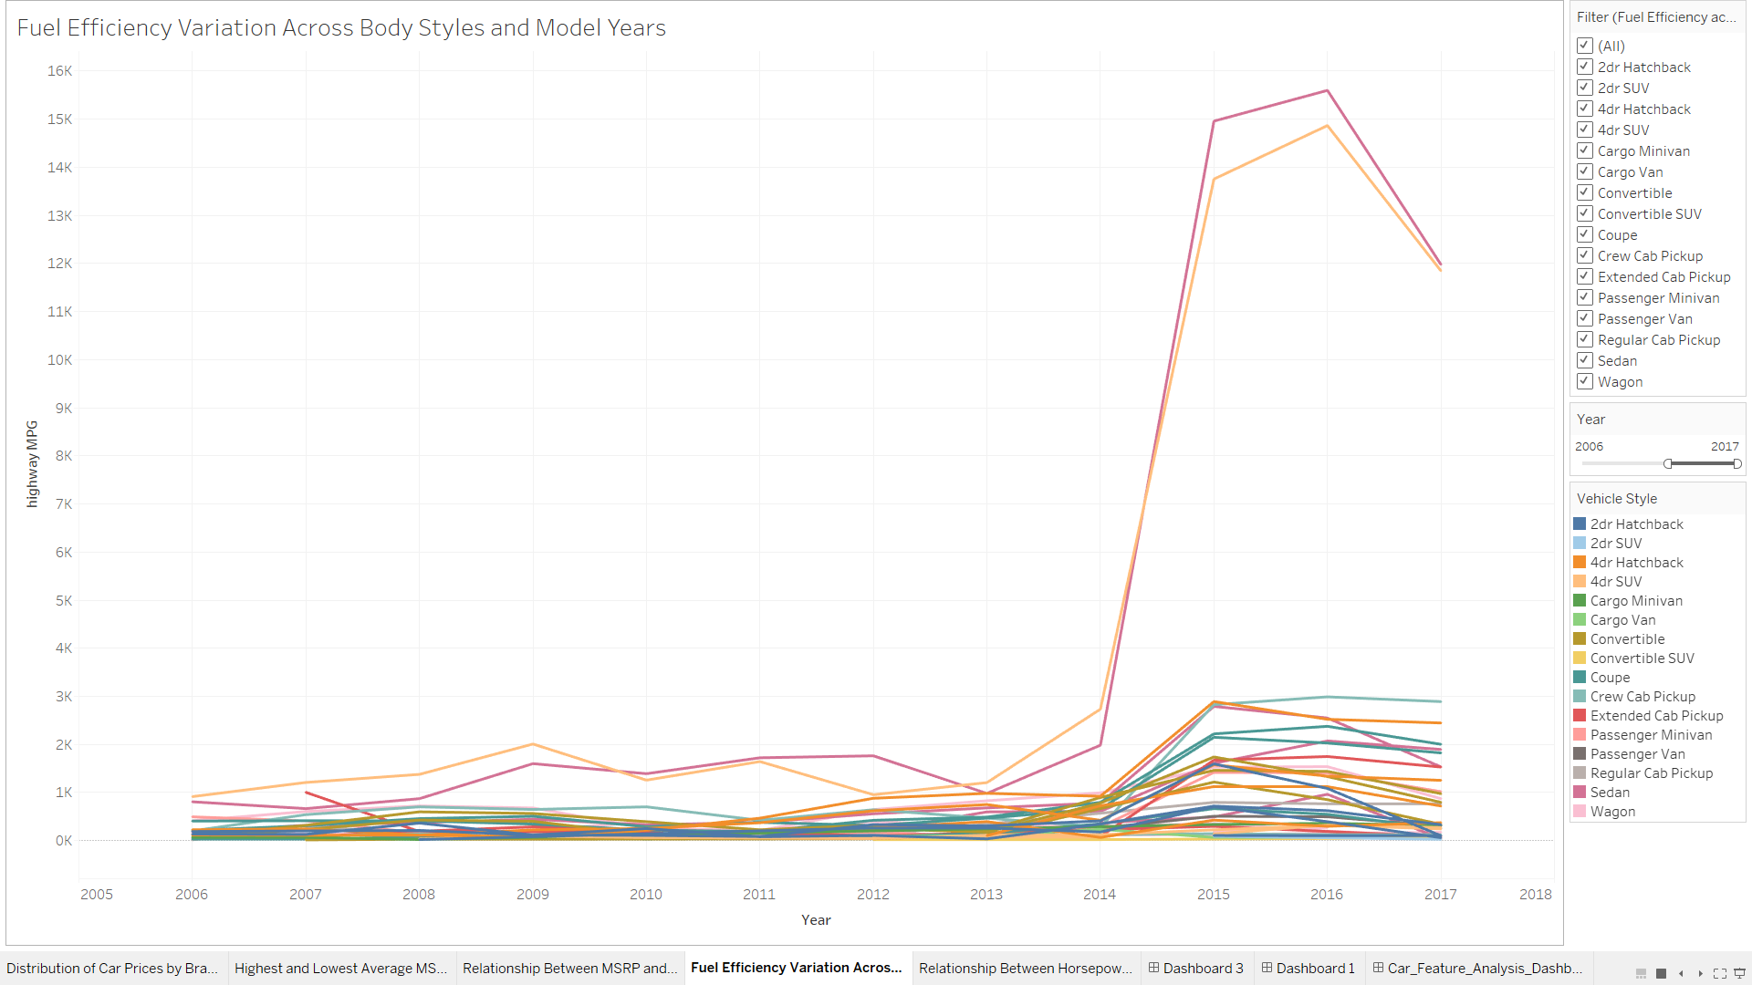
Task 4: How does the fuel efficiency of cars vary across different body styles and model years?

Slide 29
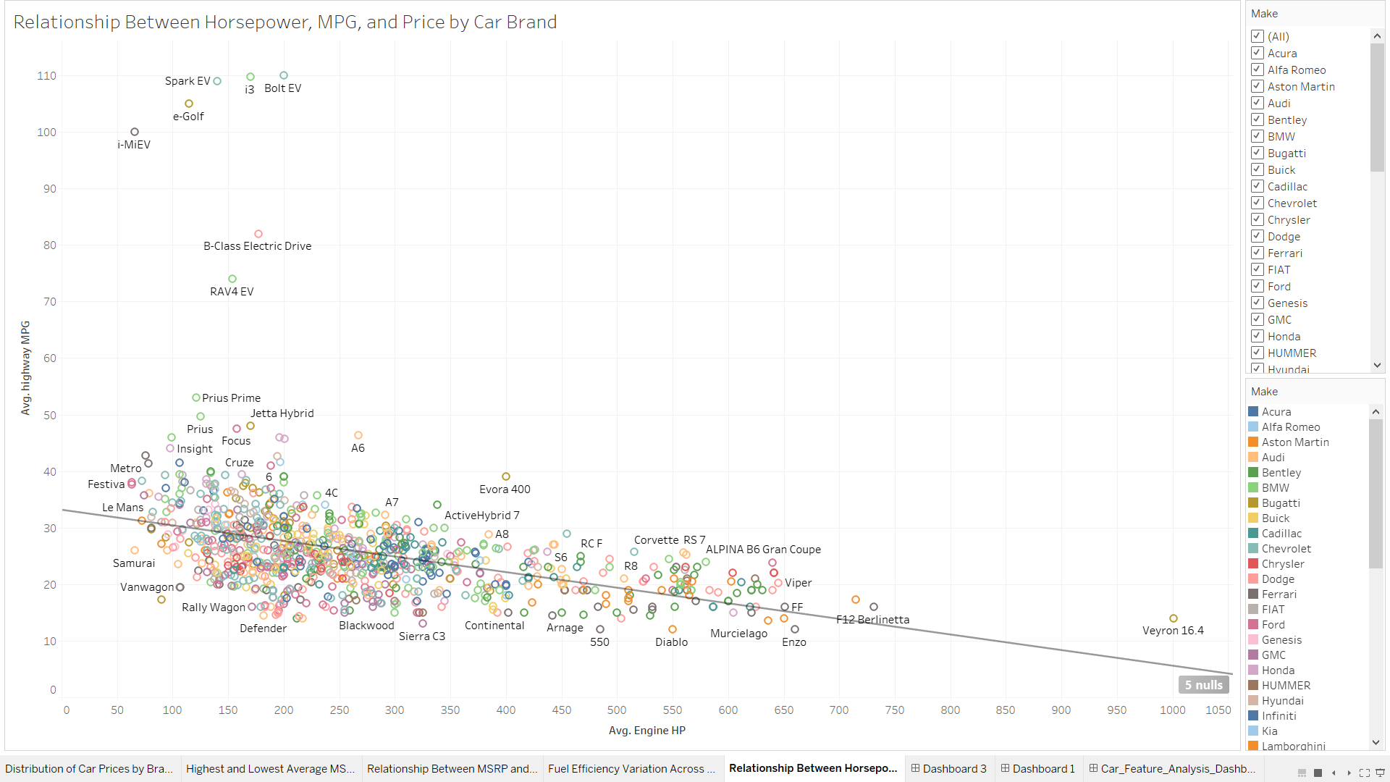
Task 5: How does the car's horsepower, MPG, and price vary across different Brands?

Slide 30
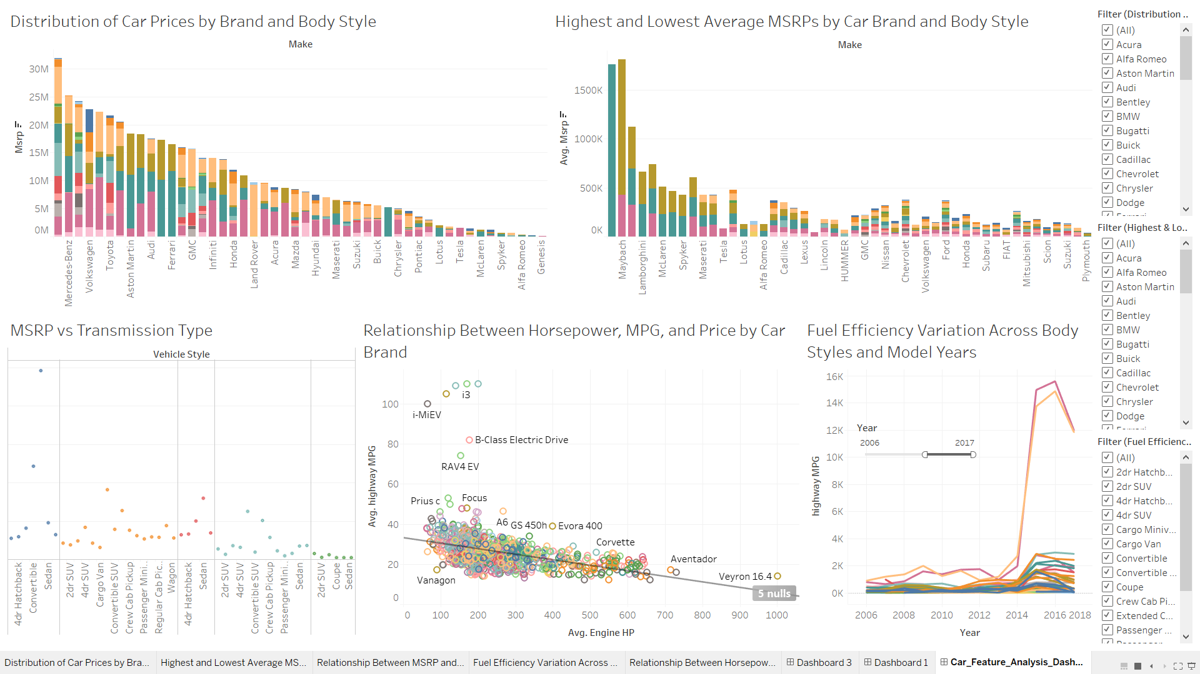
Car_Feature_Analysis_Dashboard

Slide 31
Conclusion

Slide 32
Thus, I have completed a Car Feature Analysis.
Given key findings and all meaningful trends or patterns I have discovered.
I have learned to use Python Libraries (pandas, matplotlib, numpy and seaborn) to analyze the dataset.
I have learned how to create a dashboard using Tableau Public.
I have learned to use Jupyter Notebook for Data Analysis.
GitHub Repository and drive links are given as follows.
GitHub Repository:- https://github.com/ShindeYash/Impact_of_Car_Features_Analysis
Jupyter Notebook:- https://drive.google.com/file/d/1oebLWE6TFEC1Yix7CrDRP-FvPtNPxEVj/view?usp=sharing
Drive Link:- https://drive.google.com/drive/folders/1UE-rOaYAqR_Qnp4i-erhj4NEAJKw8vyw?usp=sharing
Video Presentation:-https://www.loom.com/share/fd5d07602fa04530a0209a6bb0d357e2?sid=c97d33e5-4b25-412d-bb78-68d6d9d48c61

Slide 33
Thanks!
Do you have any questions?
yashpradeepshinde@gmail.com
Yash Shinde

